Slide 1
Python Module II
Tuple, Dictionary, Module(Package),I/O, Exception handling, Class

Slide 2
Python Tuple
A tuple is a sequence of immutable objects
The objects are enclosed within parenthesis ( ) and separated by comma.
Tuple is similar to list.
Tuple have immutable objects.
NOTE: If Parenthesis is not given with a sequence, it is by default treated as Tuple.

Slide 3
There can be an empty Tuple also which contains no object.
>>>tuple1=()
For a single valued tuple, there must be a comma at the end of the value.
>>>Tuple1=(10,)
Tuples can also be nested.
>>>tupl1='a','mahesh',10.56
>>>tupl2=tupl1,(10,20,30)
>>>print (tupl1) // ('a', 'mahesh', 10.56)
>>>print (tupl2) //(('a', 'mahesh', 10.56), (10, 20, 30))

Slide 4
Accessing Tuple
Tuple can be accessed in the same way as List.
Some examples are given below:
>>>data1=(1,2,3,4)
>>>data2=('x','y','z')
>>>print (data1[0] )
>>>print (data1[0:2] )
>>>print (data2[-3:-1])
>>>print (data1[0:] )
>>>print (data2[:2])

Slide 5
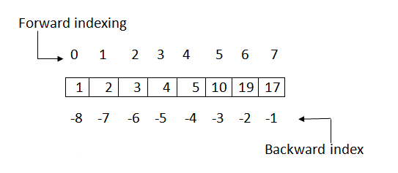
Data=(1,2,3,4,5,10,19,17)

Slide 6
Tuple Operations
a) Adding Tuple:
Tuple can be added by using the concatenation operator(+) to join two tuples.
eg:
>>>data1=(1,2,3,4)
>>>data2=('x','y','z')
>>>data3=data1+data2
>>>print( data1 ) // (1,2,3,4)
>>>print( data2 ) // ('x','y','z')
>>>print( data3 ) // (1,2,3,4, 'x','y','z‘)

Slide 7
>>>tuple1=(10,20,30)
>>>tuple2=(40,50,60)
>>>print (tuple1*2)
>>>print (tuple2*3)

Slide 8
Deleting a Tuple
# Code for deleting a tuple
tuple3 = ( 0, 1)
del tuple3
print(tuple3)
Finding Length of a Tuple
# Code for printing the length of a tuple
tuple2 = ('python', 'geek')
print(len(tuple2))

Slide 9
Converting list to a Tuple
# Code for converting a list and a string into a tuple
list1 = [0, 1, 2]
print(tuple(list1))
print(tuple('python')) # string 'python'
Output
(0, 1, 2)
('p', 'y', 't', 'h', 'o', 'n')
Takes a single parameter which may be a list, string, set or even a dictionary( only keys are taken as elements) and converts them to a tuple.

Slide 10
Using cmp(), max() , min()
# cmp() returns 0 if matched, 1 when tuple1 is longer and -1 when tuple1 is shorter
tuple1 = ('python', 'geek')
tuple2 = ('coder', 1)
if (cmp(tuple1, tuple2) != 0):
print('Not the same')
else:
print('Same')
print ('Maximum element in tuples 1,2: ' + str(max(tuple1)) + ',' +
str(max(tuple2)))
print ('Minimum element in tuples 1,2: ' + str(min(tuple1)) + ',' + str(min(tuple2)))

Slide 11
Output
Not the same
Maximum element in tuples 1,2: python,coder
Minimum element in tuples 1,2: geek,1
Note: max() and min() checks the based on ASCII values. If there are two strings in a tuple, then the first different character in the strings are checked.

Slide 12
Why Use Tuple?
Processing of Tuples are faster than Lists.
It makes the data safe as Tuples are immutable and hence cannot be changed.
Tuples are used for String formatting.

Slide 13
Dictionary in Python
In python, dictionary is similar to hash or maps in other languages.
It consists of key value pairs.
The value can be accessed by unique key in the dictionary.
Dictionary is mutable i.e., value can be updated.
Keys must be immutable.
Value is accessed by key.
Value can be updated while key cannot be changed.
Dictionary is known as Associative array since the Key works as Index and they are decided by the user.

Slide 14
# Create a new dictionary
d = dict() # or d = {}
# Add a key - value pairs to dictionary
d['xyz'] = 123
d['abc'] = 345
# print the whole dictionary
print (d)
# print only the keys
print (d.keys())
# print only values
print (d.values())

Slide 15
# iterate over dictionary
for i in d :
print "%s %d" %(i, d[i])
# another method of iteration
for index, value in enumerate(d):
print (index, value , d[value])
# check if key exist
print ('xyz' in d)
# delete the key-value pair
del d['xyz']
# check again
print ("xyz" in d)

Slide 16
Output:
{'xyz': 123, 'abc': 345}
['xyz', 'abc']
[123, 345]
xyz 123
abc 345
0 xyz 123
1 abc 345
True
False

Slide 17
Dictionary Methods in Python
1. str(dic) :- This method is used to return the string, denoting all the dictionary keys with their values.
2. items() :- This method is used to return the list with all dictionary keys with values.
# Initializing dictionary
dic = { 'Name' : ‘RAM', 'Age' : 19 }
# using str() to display dic as string
print (str(dic)) #’{'Name': ‘RAM', 'Age': 19}’
# using str() to display dic as list
print (dic.items()) #dict_items([('Name', 'Nandini'), ('Age', 19)])

Slide 18
3. len() :- It returns the count of key entities of the dictionary elements.
dic = { 'Name' : 'Nandini', 'Age' : 19, 'ID' : 2541997 }
# using len() to display dict. size
print (len(dic)) # 3

Slide 19
4. copy() :- This function creates the copy of the dictionary into other dictionary.
5. clear() :- This function is used to clear the dictionary contents.
dic1 = { 'Name' : 'Nandini', 'Age' : 19 }
dic3 = {}
# using copy() to make shallow copy of dictionary
dic3 = dic1.copy()
# printing new dictionary
print (dic3) # { 'Name' : 'Nandini', 'Age' : 19 }
# clearing the dictionary
dic1.clear()
# printing cleared dictionary
print (dic1.items()) # {}

Slide 20
Deletion: del statement is used for performing deletion operation.
An item can be deleted from a dictionary using the key.
del [key]
Whole of the dictionary can also be deleted using the del statement.
data={100:'Ram', 101:'Suraj', 102:'Alok'}
del data[102]
print (data)
del data
print (data) #will show an error since dictionary is deleted.

Slide 21
Dictionary Functions
Functions | Description
len(dictionary) | Gives number of items in a dictionary.
cmp(dictionary1,dictionary2) | Compares the two dictionaries.
str(dictionary) | Gives the string representation of a dictionary.

Slide 22
Dictionary Methods
Methods | Description
keys() | Return all the keys element of a dictionary.
values() | Return all the values element of a dictionary.
items() | Return all the items(key-value pair) of a dictionary.
update(dictionary2) | It is used to add items of dictionary2 to first dictionary.
clear() | It is used to remove all items of a dictionary. It returns an empty dictionary.
fromkeys(sequence,value1)/ fromkeys(sequence) | It is used to create a new dictionary from the sequence where sequence elements forms the key and all keys share the values ?value1?. In case value1 is not give, it set the values of keys to be none.
has_key(key) | It returns a boolean value. True in case if key is present in the dictionary ,else false.
get(key) | Returns the value of the given key. If key is not present it returns none.

Slide 23
>>>data1={100:'Ram', 101:'Suraj', 102:'Alok'}
>>>print (data1.keys() )
Output:
[100, 101, 102]
>>>print data1.values()
Output:
['Ram', 'Suraj', 'Alok‘]

Slide 24
>>>print (data1.items())
Output:
[(100, 'Ram'), (101, 'Suraj'), (102, 'Alok')]
>>>data1={100:'Ram', 101:'Suraj', 102:'Alok'}
>>>data2={103:'Sanjay'}
>>>data1.update(data2)
>>>print (data1)
>>>print (data2)
Output:
{100: 'Ram', 101: 'Suraj', 102: 'Alok', 103: 'Sanjay'}
{103: 'Sanjay'}

Slide 25
sequence=('Id' , 'Number' , 'Email')
data={}
data1={}
data=data.fromkeys(sequence)
print (data)
data1=data1.fromkeys(sequence,100)
print (data1)
Output:
{'Email': None, 'Id': None, 'Number': None}
{'Email': 100, 'Id': 100, 'Number': 100}

Slide 26
data={'Id':100 , 'Name':'Aakash' , 'Age':23}
print (data.has_key('Age'))
print (data.has_key('Email'))
Output:
True
False

Slide 27
data={'Id':100 , 'Name':'Aakash' , 'Age':23}
print (data.get('Age'))
print (data.get('Email')
Output:
23
None

Slide 28
d={int(x):z for x in input('keys ').split() for z in input('values ').split()}
keys 1 2 3 4 5 6
values a
values b
values c
values d
values e
values f
print(d)
{1: 'a', 2: 'b', 3: 'c', 4: 'd', 5: 'e', 6: 'f'}

Slide 29
Python Modules
Modules refer to a file containing Python statements and definitions.
A file containing Python code, for e.g.: example.py, is called a module and its module name would be example.
We use modules to break down large programs into small manageable and organized files.
Furthermore, modules provide reusability of code.
We can define our most used functions in a module and import it, instead of copying their definitions into different programs.

Slide 30
# Python Module example(example.py)
def add(a, b):
"""This program adds two numbers and return the result"""
result = a + b
return result
Here, we have defined a function add() inside a module named example(SAVE THE FILE WITH example.py)

Slide 31
How to import modules in Python?
We can import the definitions inside a module to another module or the interactive interpreter in Python.
>>> import example
>>> example.add(4,5.5)
9.5

Slide 32
1. Python import statement We can import a module using import statement and access the definitions inside it using the dot operator.
# import statement example
# to import standard module math
>>>import math
>>>print("The value of pi is", math.pi)
The value of pi is 3.141592653589793

Slide 33
2. Import with renaming We can import a module by renaming it as follows.
>>># import module by renaming it
>>>import math as m
>>>print("The value of pi is", m.pi)

Slide 34
3. Python from...import statement We can import specific names form a module without importing the module as a whole.
>>># import only pi from math module
>>>from math import pi
>>>print("The value of pi is", pi)

Slide 35
>>> from math import pi, e
>>> pi 3.141592653589793
>>> e 2.718281828459045

Slide 36
4. Import all names We can import all names(definitions) frm a module using the following construct.
>>># import all names form
>>># the standard module math
>>>from math import *
>>>print("The value of pi is", pi)

Slide 37
Reloading a module
The Python interpreter imports a module only once during a session.
Suppose we have the following code in a module named my_module.
>>># This module shows the effect of multiple imports and reload
>>>print("This code got executed")
Now we see the effect of multiple imports.
>>> import my_module
This code got executed
>>> import my_module
>>> import my_module

Slide 38
Now if our module changed during the course of the program, we would have to reload it.
One way to do this is to restart the interpreter.
Python provides a neat way of doing this.
We can use the reload() function inside the imp module to reload a module.
>>> import imp
>>> import my_module
This code got executed
>>> import my_module
>>> imp.reload(my_module)
This code got executed <module 'my_module' from '.\\my_module.py'>

Slide 39
Python Package
We don't usually store all of our files in our computer in the same location.
We use a well-organized hierarchy of directories for easier access.
Similar files are kept in the same directory, for example, we may keep all the songs in the "music" directory.
Analogous to this, Python has packages for directories and modules for files.
As our application program grows larger in size with a lot of modules, we place similar modules in one package and different modules in different packages.
This makes a project (program) easy to manage and conceptually clear.

Slide 40
Similar, as a directory can contain sub-directories and files, a Python package can have sub-packages and modules.
A directory must contain a file named __init__.py in order for Python to consider it as a package.
This file can be left empty but we generally place the initialization code for that package in this file.

Slide 41
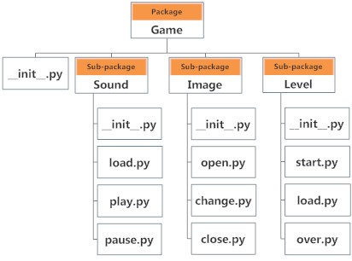

Slide 42
Importing module from a package
We can import modules from packages using the dot (.) operator.
For example to import the start module in the above example
And if this module contains function named select_difficulty()
>>>import Game.Level.start
>>>Game.Level.start.select_difficulty()
OR
>>>from Game.Level import start
>>>start.select_difficulty()

Slide 43
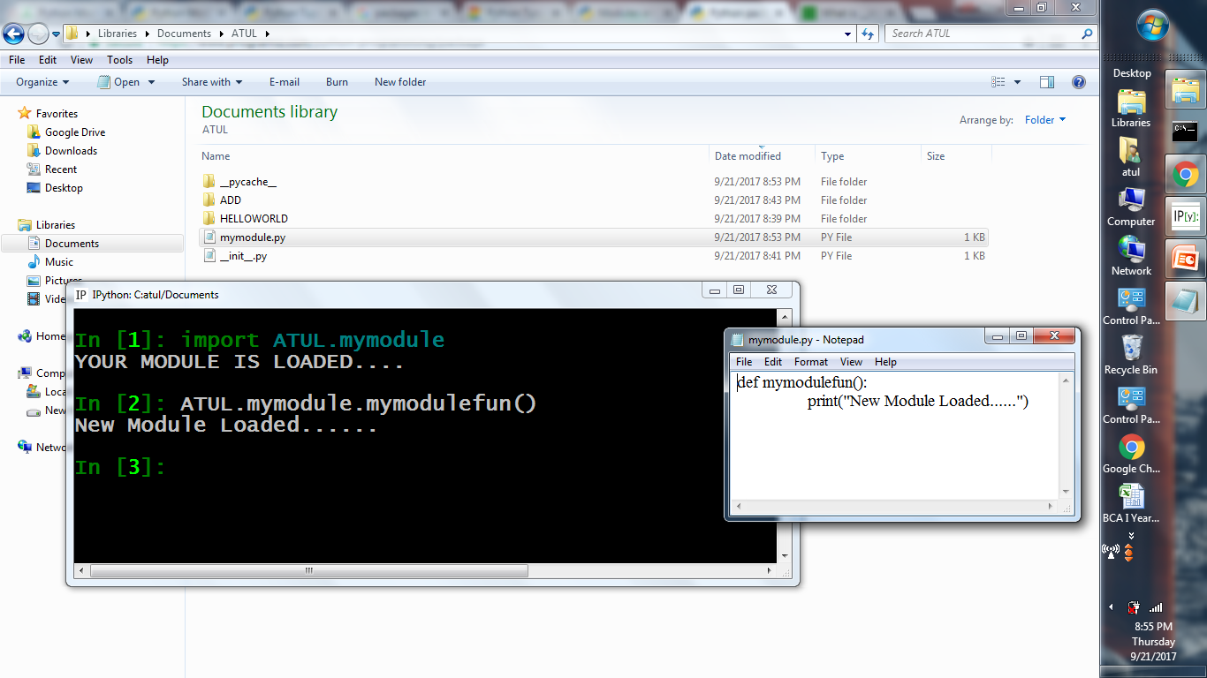

Slide 44
